Slide 1


Your Name & Title Goes Here
20
19
FUTURE-PROOFING THE BUSINESS
REPORT

Slide 2

Introduction
Future-Proofing the Business
Overview of Insights
There’s Never Been a Better Time for Creativity
Trends
Creative Experience Is the New CX
Playing Nicely in the Brand House
Collective Creativity: Tech + Creativity Working Together
Applying Madness to Methodology
Takeaways
Change the Talent Paradigm
Creative Democratisation
Finding the Right Method & Model
2

Slide 3
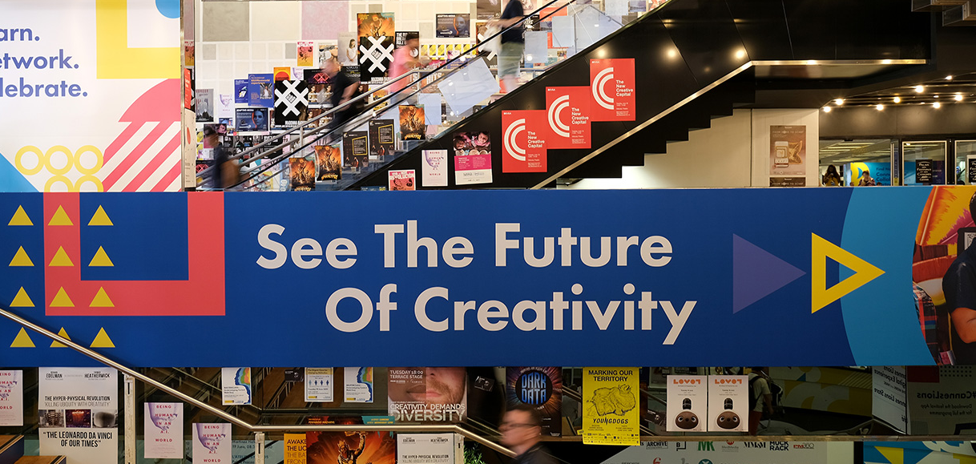

Future-Proofing the Business
Introduction
In-house marketers have long relied on agency relationships
for producing great creativity and effective communications.
But things are changing. Marketing has become extremely complicated and a lot more challenging. Budgets have decreased, while technology spending has increased. The pressure to deliver immediate, measured ROI has become an everyday reality. And marketers need solutions to these complex business issues that are faster, better, and cheaper. The net effect has been tension between marketers and the ever-changing partner landscape.
The biggest question, however, is what does this mean for creativity today? Is creativity even important anymore?
In short, the answer is yes. Creativity is more important now than ever, no matter which side you sit on. But a question that underlies the creativity debate is who will do the work?
Will it be traditional holding company agencies or a full-service digital agency? Is it specialist agencies or even a combination
of agencies? And what about in-house agencies, which are increasingly becoming a go-to option for marketers. In fact, the Association of National Advertisers/ANA recently released findings that indicate 78 percent of brand marketers now have some form of in-house agency operations today vs. 58 percent in 2013. Or is it a whole new model offered by consultancies? We’ll tackle these questions on the following pages.

Slide 4



There’s never been
a better time for
creativity.
Under the bright sun and big lights of the
Cannes Lions, one thing has rang true throughout this year’s Festival: there’s no better time for creativity than today!
Time and time again, iterations of this proclamation were mentioned. Be it David Droga suggesting the unique marriage between Droga5 and Accenture Interactive is actually ‘a way to save creativity,’ or Sean Lyons of R/GA who said, ‘Creativity can impact every level of business.’
One of the world’s largest tech giants, Samsung, believes that there is a new generation for all of us to use creativity to appeal to: a generation of dreamers with purpose.
Capitalize on low hanging fruit
to identify a ballpark

Slide 5


There’s never been
a better time for
creativity.
Creativity is more important than ever.
However, against this rosy headline lurks significant challenges for the industry. Decreasing budgets, increasing pressure on marketers for immediate ROI, and the limited tenures of CMOs.
Moreover, the idea of brands taking their creative work in-house is as real today as ever. Yes, they’ve taken elements of channels or programmatic media in-house in the past, but today there’s a genuine effort, or at least discussion, to take large-scale, big ideation in-house.
Adding fuel to the creativity debate is the realisation that agency/client relationships have seen better days. Inadequate compensation models,
frustrating processes, and uninspiring work has the industry asking, what is the future of creativity?
Through this prism, we’ve identified four key trends. The first covers the age-old question: Does creativity work? A new study from Forrester indicates that creativity is fundamental to the success of a business.
Our second trend deals directly with the
in-housing vs. agency debate. You may be
surprised by the findings.
The third trend tackles the assertion that technology has, in fact, dampened creativity. The conclusion is
that technology and creativity must work
together to create lasting change.
And finally, despite the challenges the industry
is facing, a key way forward in future-proofing creativity is to stay relevant and reinvent.
While this may seem obvious, there are agencies, consultancies, and brands staying ahead of the curve to expand creativity by introducing new processes, methods, and collaborations to create great work.
There’s never been a better time for creativity,
but it’s incumbent upon all of us to work smarter and more nimbly.
Capitalize on low hanging fruit
to identify a ballpark
1

Slide 6
Theme: Future-Proofing the Business
Trends
02
04
Playing Nicely in the Brand House
Applying Madness to Methodology
01
03
Creative Experience Is the New CX
Collective Creativity: Tech + Creativity Working Together
There have been very spirited debates throughout the festival regarding the pros and cons of in-housing over outsourcing, and what is the true level of creativity that can be produced in-house.
Some brands are moving bigger idea thinking in-house and loving it. Conversely, many agency folks are adamant it just won’t work.
But the truth is, it’s not an either-or situation (just yet).
Those using both models, or a hybrid, are finding success. So there’s plenty of room for everyone in the house.
When the going gets tough, agencies lean on their survival instincts to create new ways to heighten their creativity.
In order to future-proof an organisation, you have to stay relevant.
Explore the unique ways marketers and agencies alike are turning to new methods and new approaches to stay relevant and drive revenue.
Investing in creativity works. And now, thanks to Forrester, there’s proof that investing in creativity will result in higher ROI.
Using Forrester’s CX Index data, they have modeled a view that recommends a shift in spending towards creativity, with increased ROI for marketers.
Technology and creativity must work together to harmoniously solve marketers’ problems today.
Pairing human insights aimed at solving consumers’ pain points with technology can actually bring humanisation to campaigns and deliver game-changing results.

Slide 7
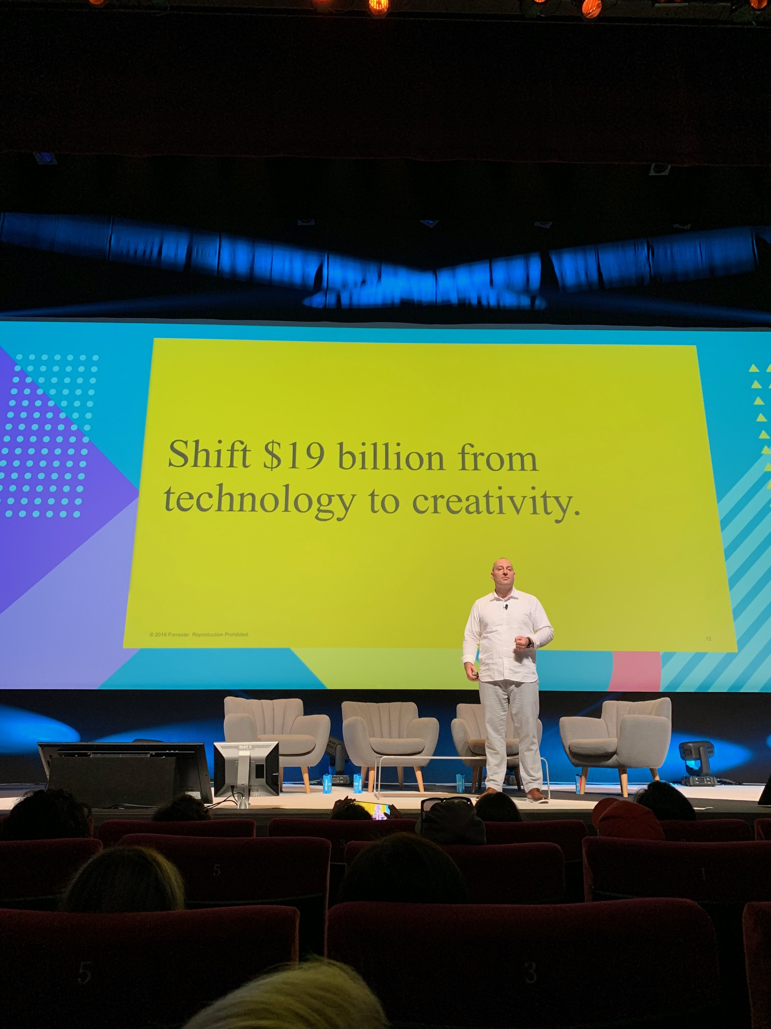
01
Creative Experience Is the New CX
One of the more riveting sessions this year was Forrester’s The Value of Agency Creativity.
Using Forrester’s US CX Index, an annual survey of over 100,000 customers and 300 brands, Jay Pattisall illustrated an unhealthy tension in delivering creative today. This is driven by insourcing, disproportionally high tech spending, and agency cost-cutting.
Given the above, Forrester maintains customer experience is stagnating and brands are languishing. In the rush to spend more on tech, brands have under funded creativity and, in doing so, homogenised customer experiences. Pattisall stated ‘Digital sameness is pervasive and therefore, what makes any brand different from another?’
While brands will need to keep some investment in foundational technology like data, analytics, and marketing automation to service the overall organisation, this isn’t true for all technologies.
The answer: shift $19 billion from tech investment to agency creativity over the next six years, which will:
Produce higher returns compared with current tech spending levels
Adjust spending in declining tech categories
Provide firms with a multiyear growth plan
If brands make this shift, the net return will be an increase of $10 billion, an ROI increase of 20 percent more than if the shift wasn’t made.
$10B
Capitalize on low hanging fruit
to identify a ballpark
The value of agency creative is $10 Billion
– Jay Pattisall, Forrester

Slide 8


If agencies could get their shit together, then maybe OK.
02
Playing Nicely in
the Brand House
– Paulie Dery, ECD of Uber
In-house agencies are not a new phenomenon. Remember Lintas? That agency was formed
in 1899 as Lever Brothers’ (now Unilever)
in-house agency. The agency went on to
be a global player.
For the better part of this year, however, the debate over in-house agencies has continued at a fever pitch about the likelihood of in-housing’s ability to produce new, big brand ideas.
Can they do it? Or will it fail? Should big
idea creation be left to agencies? Or are
there other models?
Well, if the news of Procter & Gamble bringing Secret in-house as their brand team replaces Wieden+Kennedy is any indication, in-housing is on an uptick. But it depends on whom you ask.
Uber, Spotify, Apple, and Twitter are ardent supporters of in-house creativity. Buoyed by great in-house talent, they believe (and have shown) in-housing is capable of award-winning ideas. They maintain that in-house creatives know the brand best and work in the same office as the CMO.
Those on the agency side say not so fast. Justin Billingsley, CEO of Publicis Emil, points to three issues why in-housing isn’t working: 1) Limited talent, 2) Lack of diversity and exposure to proper stimulation, and 3) Lack of tension in the
creative process in-house.
The underlying reality is the industry has fundamentally changed, forcing brands to explore different models. And it may never go back to ‘normal.’ Oatly, a Swedish oat milk company, even created a whole new model.
John Schoolcraft, Oatly Creative Director, says, ‘We have a creative department called the Oatly Department of Mind Control where we brief ourselves, do the work, and then approve our own work. This is completely the opposite of an in-house agency because an in-house agency has to listen to a marketing department, which in our opinion is the worst possible set-up of all.’
Despite strong beliefs, there is a silver lining.
‘It’s not an either-or. It’s how we work together,’ proclaimed Paulie Dery, ECD of Uber.
Ultimately, brands will choose their model; in-housing, a hybrid model, or outsourcing to
an agency. Whatever the case, they’ll all need
to play well in the sandbox for the common
good of the brand so long as the focus is
on great creativity!

Slide 9
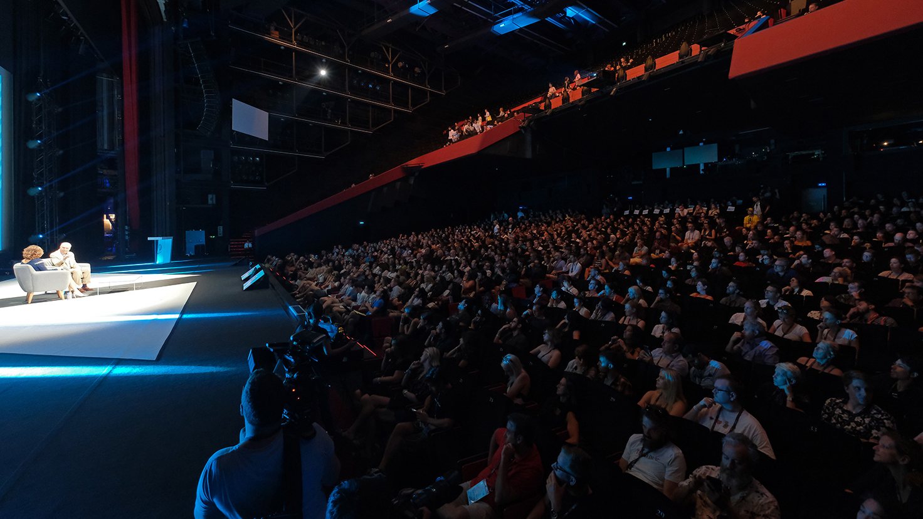
03
Collective Creativity: Tech + Creativity Working Together
So much has been made of whether technology,
most notably artificial intelligence, is killing creativity
or eliminating industry jobs. The truth is technology
and creativity must coexist now more than ever.
Across many sessions, panelists supported the notion
that technology is critical to future success. That’s why there’s been investment. As Forrester points out, the
CMO now has the fastest-growing tech spend in the
C-Suite, projected to grow between 9 percent and 11 percent from 2017 to 2022.
However, all this investment will in no way overtake the fundamental human attributes of curiosity, imagination, and invention. Applying insightful creativity in an analog, meditative space and coupling that with technology is where the magic happens. Burger King’s Global Head of Brand Management, Marcelo Pascoa, noted, ‘Artificial intelligence is not a substitute for a great creative idea coming from a real person.’
But hold on, Marcelo, Lexus might beg to differ. Lexus
and their agency, The&Partnership, created the first ad written by artificial intelligence, which was engineered by analysing 15 years of Cannes-Lion-winning car ads. See the ad for yourself at: https://youtu.be/a2_smFoqQUg and you can decide.
Meanwhile, David Droga, who appeared with Accenture Interactive’s CEO, Brian Whipple, claimed that the marriage of Droga5 and Accenture Interactive is ‘a way to save creativity. I have clients coming in asking for more. They’re building a business, not just an ad.’ Whipple continued by saying, ‘We need technology and creativity to reinvent experiences.’
Whatever the future holds, Burger King’s Pascoa wants you to remember, ‘Technology is not the enemy.
Tech is what makes the impossible possible. And if you embrace it, you’re in a much better position to survive the apocalypse.’

Slide 10
04
Applying Madness to Methodology
To stay ahead of the rapidly changing business and remain relevant to both clients and consumers, many agencies are reinventing the process of creativity or creating new ways of approaching the process. The result has been the introduction of new methods and even new revenue streams. Essentially, it’s a reinvention of the way to get to great work.
But whatever you do, don’t call it collaboration!
Agencies like Serviceplan and Rothco are introducing new methods
to get to better creative. Serviceplan’s Executive Creative Director,
Jason Romeyko, calls their approach UberCreativity, a higher form of creative that brings all disciplines together. Romeyko uses a process called the Wigwam, a ‘territory of explosive creativity’ that drives hundreds of ideas in three days.
Rothco looked to open their process to others to drive innovative work. They call it Polyamorous Creativity, which takes a team from a typical twosome to a sixsome (yes, sexual innuendos were included).
Guide to Managing a
Polyamorous Relationship
Everyone must be into it
Respect all members of the relationship
Make space for someone new
Communicate openly
Expect it to be hard
If it doesn’t work as two, it won’t work as ten
Don’t keep score
Remain flexible
Don’t be jealous
- From Rothco

Slide 11



04
Applying Madness to Methodology
Mesa, a team-based work system in Brazil, has crafted a philosophy that makes work 100% fulfilling, allowing brands to conceive, develop, and prototype extraordinary solutions in five days. Their methodology is comprised of three elements: A leader + a team with the knowledge + A mission. The process is wrapped in a series of rituals, but drives new solutions in a compressed time.
R/GA, an agency that is constantly reinventing the industry and itself, has
created R/GA Ventures, which works to fund startups. Through the application
of Financial Capital + Relationship Capital + Creative Capital, they’re paving a new way of bringing cutting-edge technology solutions to market. Their methodology of 1) Altitude, 2) Implementation, and 3) Outcomes works so
well, R/GA applies it to existing clients.
Collaboration is like happiness… the more you focus on it, the less you get it… So let’s stop using the word collaboration.
—Barbara Soalheiro, Mesa

Slide 12



Takeaways
Change the
Talent Paradigm
Creative Democratisation
Finding the Right Method & Model
In order to usher in new creativity in the industry, we need to look outside of traditional agency and creative talent funnels. We heard several creative thought-leaders this week talk about the quality of creative work coming from unexpected experiences and people—beyond thinking about diversity from an identity perspective—and extending to
life and prior work experience.
Forrester’s Employee Experience Index suggests creativity helps organisations build a culture that attracts talent, and that inspiration is inextricably tied to the brand’s ability to impart a belief in the core mission and vision.
To prospective talent, are you seen as a forward-looking, innovative company?
Today, more than ever brands reflect our culture. Creativity has mostly been achieved in a controlled environment (approved by rational people), but now it’s been democratised, even to the point that now everyone IS their own brand.
In a sense, creativity is really a team sport, requiring a group of people, a shared economy, and ultimately, shared creativity.
This requires staying relevant with consumers and changing in real time. Call it branding in real time, where everyone should be a creative stakeholder.
How relevant is your brand today, and how flexible are you in this shared economy?
As reported in the fourth Trend, there are a multitude of innovative methods pushing the creative process towards great work.
We also looked at different creative models in the second Trend from in-housing, working with an agency, or a combination thereof.
Given there is no better time for creativity, there’s no better time to explore or evolve your model and ensure you’re future-proofing your business with best-in-class, award-winning methods and models.
Which method or model works for you?
Find the right one, and who knows, we might see you on stage next year at Cannes.
Change the Talent Paradigm
Creative Democratisation
Finding the Right Method & Model
In order to usher in new creativity in the industry, we need to look outside of traditional agency and creative talent funnels. We heard several creative thought-leaders this week talk about the quality of creative work coming from unexpected experiences and people—beyond thinking about diversity from an identity perspective—and extending to life and prior work experience.
Forrester’s Employee Experience Index suggests creativity helps organisations build a culture that attracts talent, and that inspiration is inextricably tied to the brand’s ability to impart a belief in the core mission and vision.
To prospective talent, are you seen as a forward-looking, innovative company?
Today, more than ever, the reflection of brands reflects our culture. Creativity has mostly been achieved in a controlled environment (approved by rational people), but now it’s been democratised, even to the point that now everyone IS their own brand.
In a sense, creativity is really a team sport, requiring a group of people, a shared economy, and ultimately, shared creativity.
This requires staying relevant with consumers and changing in real time. Call it branding in real time, where everyone should be a creative stakeholder.
How relevant is your brand today, and how flexible are you in this shared economy?
As reported in the 4th Trend, there are a multitude of innovative methods pushing the creative process towards great work.
We also looked at different creative models in the 2nd Trend from in-housing, working with an agency, or a combination thereof.
Given there is no better time for creativity, there’s no better time to explore or evolve your model and ensure you’re future-proofing your business with best-in-class, award-winning methods and models.
Which method or model works for you?
Find the right one, and who knows, we might see you on stage next year at Cannes.

Slide 13
Thank You
Your Name & Title Goes Here

Slide 14

Feel Free to Share this with Your Team
1.
2.
Click the icon in the lower left corner box to add your logo
Copy + paste your logo onto each of the slides
You can delete the “Experience Created by Accenture Interactive” part—we’ll keep that just between us!

