Slide 1






Your Name &
Title Goes Here
20
19
DIVERSITY, INCLUSIVITY & ACCESSIBILITY
REPORT

Slide 2
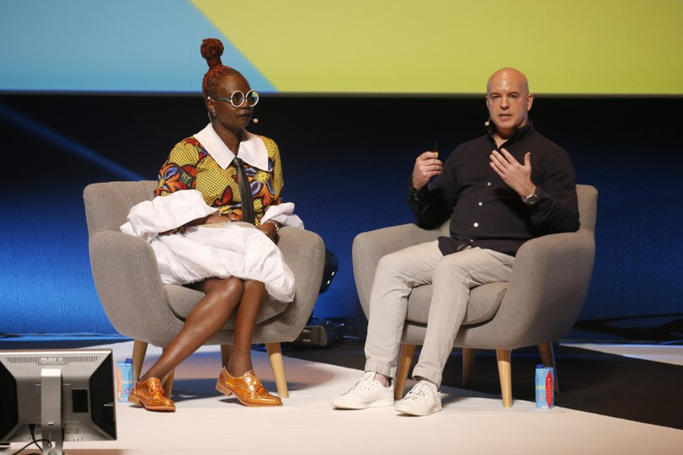
Introduction
Diversity as a stand-alone topic
Overview of Insights
A review of the cultural moments and industry work that led to this year’s emphasis on diversity, inclusivity and accessibility.
Trends
Intersectionality
Intrinsic Inclusivity
Perennial Engagement
Feminism to the Front
Reimagining How Inclusion Looks
Takeaways
What we as industry leaders need to do to make our organisations and work more diverse and compelling for diverse audiences.
From left to right: Target’s Chief Diversity Officer, Caroline Wanga, and Chief
Creative Officer, Todd Waterbury, from Monday’s A Circle Big Enough for Us All

Slide 3
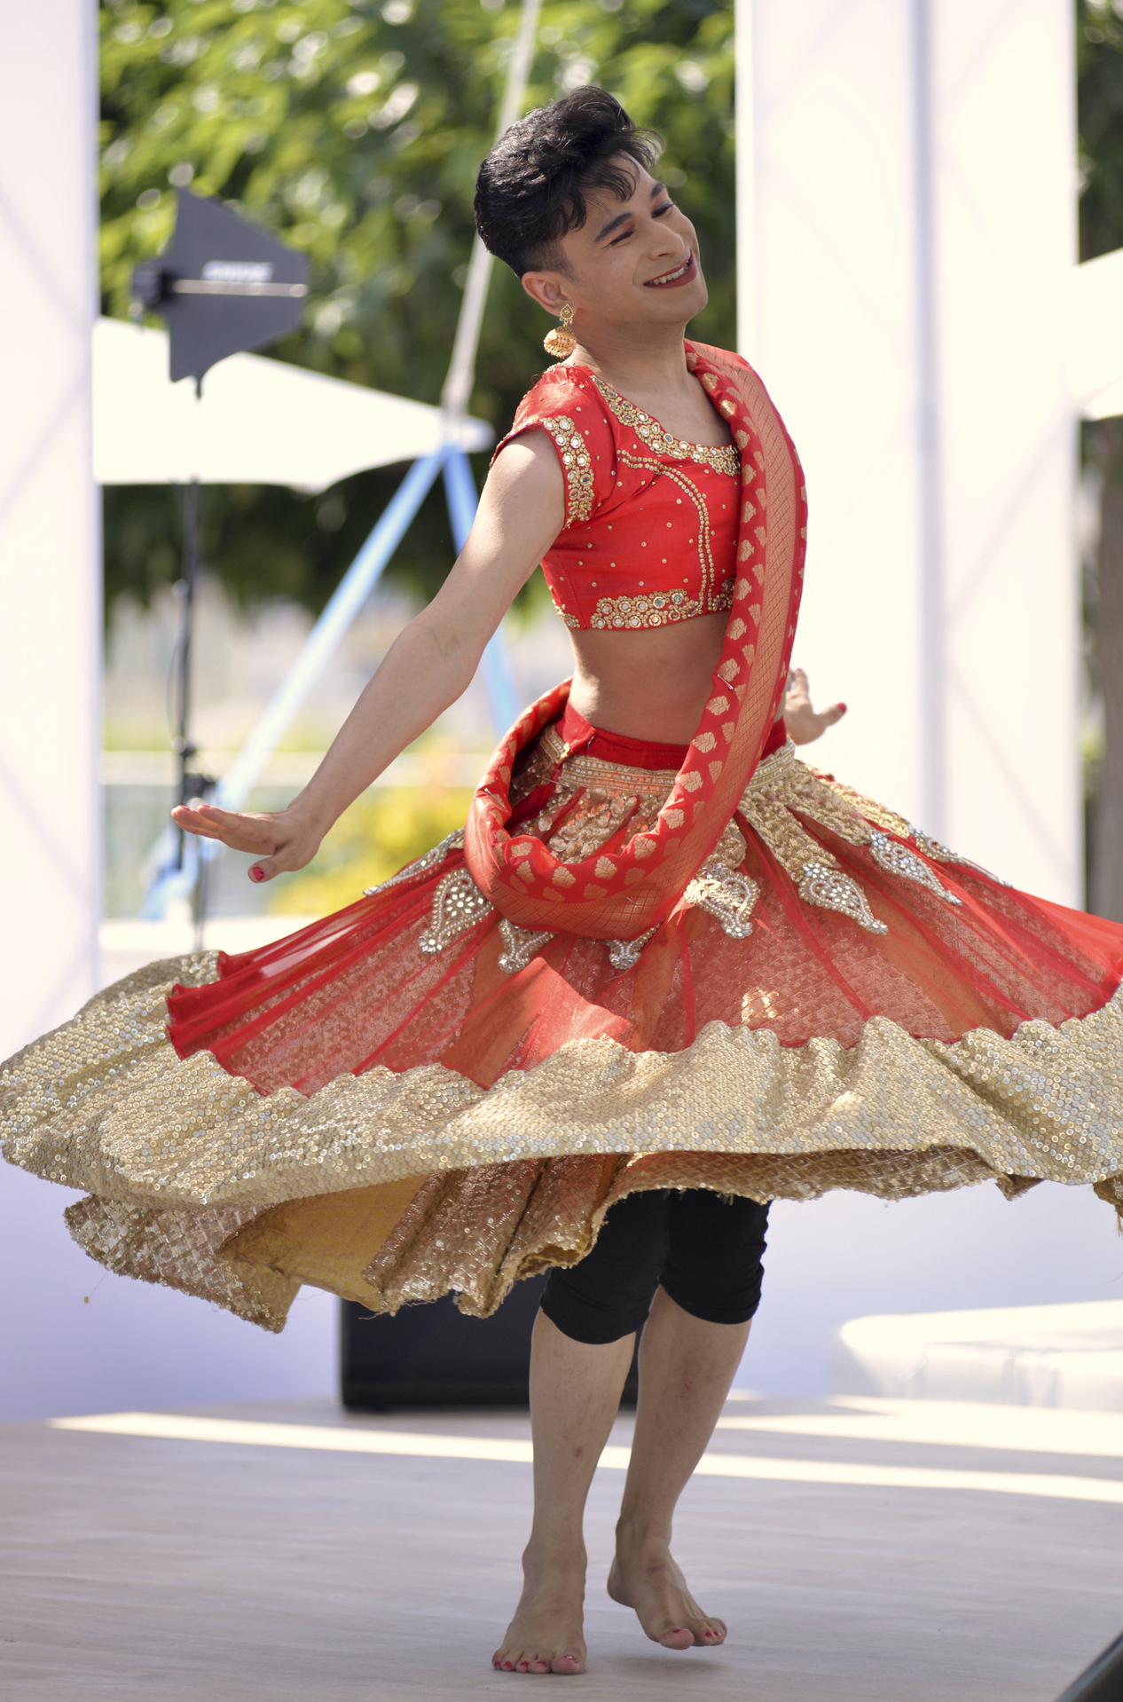
Diversity, Inclusivity & Accessibility
Introduction
This year’s Cannes Lions International Festival of Creativity brought to life a powerful emphasis on diversity, both as a stand-alone topic and woven throughout sessions, brands’ presences, and awards.
See how the industry is evolving its internal core values, diversifying business objectives and marketing efforts, and rightsizing historic inequality and underrepresentation.
Shiva Raichandani, a principal dancer and lead instructor of London School of Bollywood and former contestant of Britain’s Got Talent, India’s Got Talent, and France’s Got Talent, performing during Monday afternoon’s Why We Don’t Need Another Diversity Talk.

Slide 4
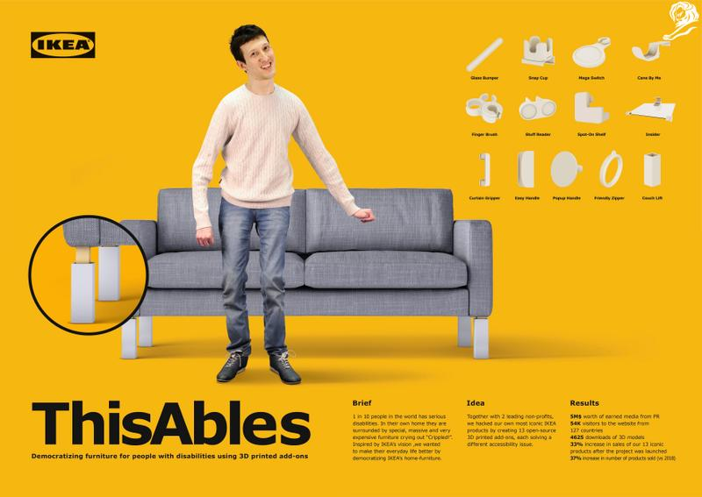
A Dissertation
on Diversity
Across industries, this year’s Festival delivered a masterclass on the importance of representation— ideas and policies on diversity, inclusivity, and accessibility—shifting from tokenism and opportunistic campaigns to meaningful investments in brand values and commitments.
This Festival was arguably the most intersectional in its history. Nearly every session referenced diversity as a stand-alone topic and as an element driving change more broadly. Brands finally put their money where their ads have been—including the Lions themselves, with concurrent, diversity-minded programming premiering this year in partnership with the Cannes Can: Diversity Collective.
Capitalize on low hanging fruit
to identify a ballpark
Health & Wellness Grand Prix winner, ThisAbles by McCann Tel Aviv for IKEA. Made in full collaboration with two of the biggest accessibility organisations in Israel, Milbat and Access Israel, both nonprofit organisations that specialise in providing accessibility to people with disabilities.

Slide 5
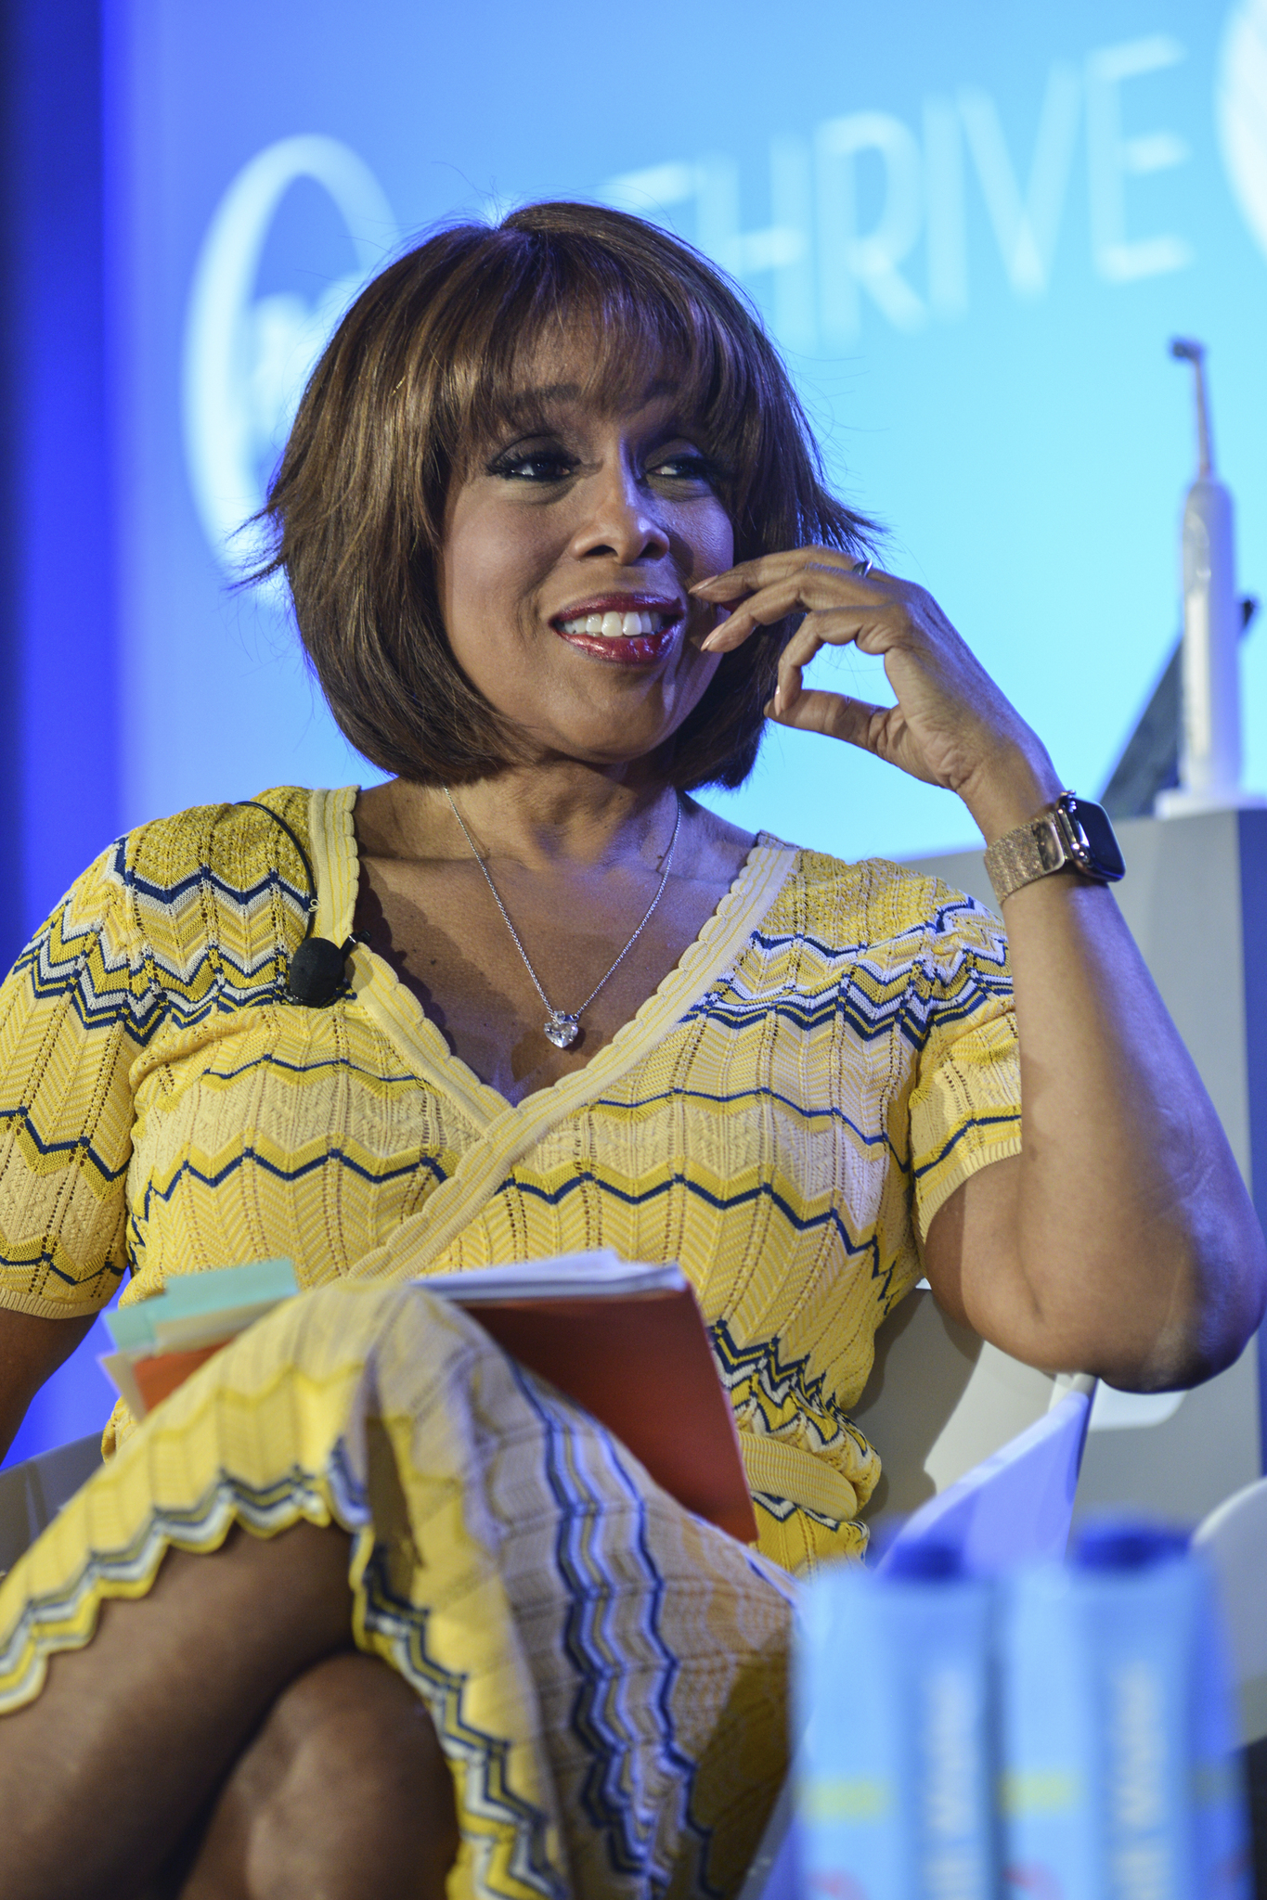

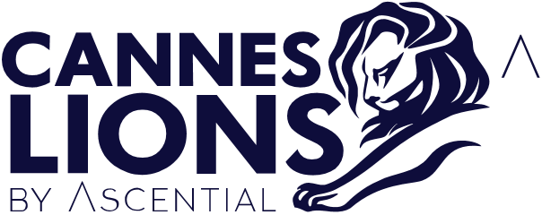
Diversity Given Stand- Alone Attention
I thought there should be one consolidated space where more subject matter experts of colour and underrepresented communities could be heard and seen. My goal is to also help to elevate the conversation beyond the topic and show what it looks like in action.
– Adrianne C. Smith, Founder of Cannes Can: Diversity Collective, speaking to Forbes about Inkwell Beach
You couldn’t attend a Festival session this year without hearing a reference to diversity. But what did they mean? From speakers, within the work and events, diversity was defined across race and ethnicity, LGBTQIA+ identities, gender and its expression—with extra emphasis on women—religious freedom, age, and ability.
Each of these elements of diversity manifested on another plane: imperatives for organisations’ purpose or operations, for their market-facing creative outputs, and for the service of their people—be it staff or consumers.
To the keen cultural observer, it’s not hard to understand why this macro-topic deserves stand-alone attention…
In 2017, the Cannes Can: Diversity Collective (CC:DC) began to address concerns that the Lions, along with the industries and work it celebrated, were ignoring the contributions of communities of colour. Just two years later, the Collective and the Lions partnered to premiere Inkwell Beach Cannes. Named as a tribute to a historically black beach on Cape Cod, USA, the initiative created concurrent programming dedicated to underrepresented talent, work, and communities served.
But the Festival’s history and timing of diversity as a ‘trend’ is likely iterative of the global industry zeitgeist of 2019, one where people are driven and remain loyal to brands and creators anchored by purpose, hyper-cultural relevance, and mirrored values and makeup of the communities they serve.
Gayle King, speaking at Thrive Global’s Unleashing Creativity to Fuel Health, Habits & Humanity. King also spoke
at Inkwell Beach Cannes.

Slide 6
Diversity, Inclusivity & Accessibility
Trends
02
04
Intrinsic Inclusivity
Feminism
to the Front
01
03
05
Intersectionality
There’s a difference between diversity—a somewhat superficial investment—and inclusivity, which ingrains itself into the fabric of a brand. In several panels this week, we heard thought-leaders articulate why the premise of inclusivity is inherent to the efficacy of diversification efforts.
Perennial Engagement
#TimesUp continues to change the leadership in advertising. On the heels of the movement, presenters outlined the overall value that women in leadership build for our industries: increased brand health, higher market performance, and greater relevance and connectivity with customers.
Reimagining How Inclusion Looks
Intersectionality is the plural ways in which populations can be marginalised based on multitudes of identities. While some sessions focused on select elements of diversity most relevant to their ideas, many addressed the full spectrum of diversity and inclusivity—all for one and one for all!
Shifting from seasonal platforms and opportunistic marketing, brands and organisations advocated for always-on approaches to both internal and market-facing efforts that build inclusive and hyper-relevant campaigns.
Speaking of time, there are populations that rarely get any of ours in the industry. When was the last time you received or wrote a brief meant for folks 50 years old or older? How often does accessibility play a part of your strategy or creative?

Slide 7

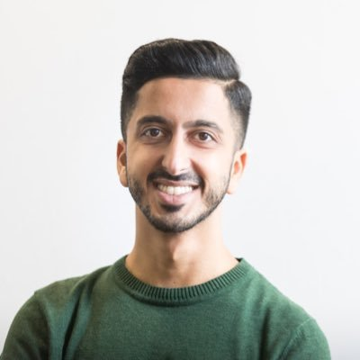
01
The Muslim market is massively underserved in countries like the UK, in France. Billions of pounds, or euros, or dollars are being missed because mainstream brands don’t know how to target and create campaigns that are really creative, but to a different audience.
Intersectionality
While diversity was referenced in many sessions this year, discussions underscored the importance of understanding diversity as defined in individualistic, human terms.
The idea of intersectionality is that there are multiple identities we hold. For advertisers, brands, and creatives, that’s been seen as a challenge or limitation in the past. Why should we feature a transgender woman of colour, for example, if there are likely fewer individuals in my audience who fit that specific identity set?
This year, thought-leaders flipped the idea of intersectionality into opportunity. That example of a transgender woman of colour is now a powerful creative force.
She brings value, relevance, and cultural
nuance that addresses multitudes of
—Asad Dhunna, Founder of The Unmistakables, a cultural consultancy, speaking to Euro News
populations—women, people of colour,
and LGBTQIA+ individuals.
Monday afternoon’s Terrace Stage – LGBTQ Programme was a great example of this intersectionality. Out of the six sessions, five included people of colour and five included trans*, non-binary, or gender fluid individuals. One session included a person of different ability, and
speakers’ ages ranged from college-aged
Gen Z to seasoned professionals familiar
with the Cannes stages.
Intersectionality made it to main stages too. Tuesday featured a session named for it—Getting Intersectionality in Advertising Right,
hosted by the Geena Davis Institute on Gender in the Media, where speakers advocated for ‘vigilance’ in addressing representation disparities, across race and sexual identity too.
​​
Tommy Hilfiger Adaptive won a Silver Lion in
Design for its accessible apparel line and campaign in partnership with Wunderman Thompson New York. In bringing the global campaign to life, they exhibited each person of different ability with a variety of backgrounds, perspective of need, and insights for the brand. This campaign was also helmed by a blind director, just one example of the next trend from this year’s events—inclusivity.

Slide 8
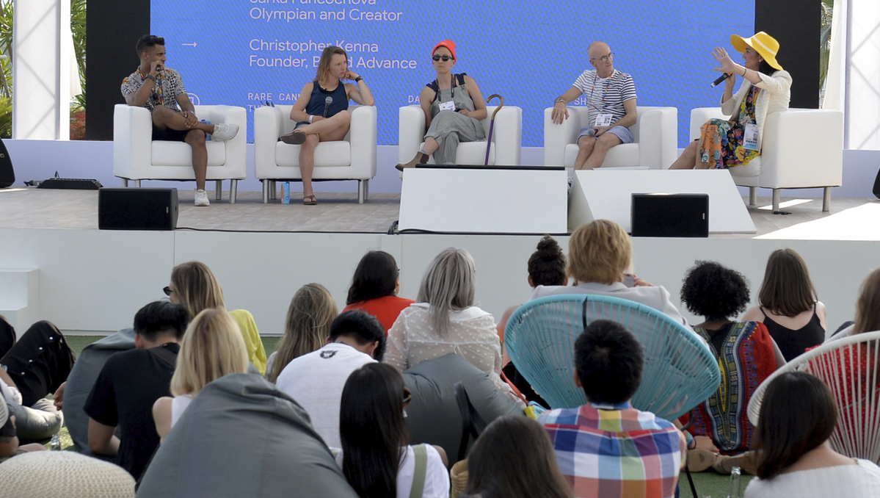

02
Target’s session, A Circle Big Enough for Us All, illustrated a marriage between diversity and brand purpose.
Target’s CCO, Todd Waterbury, said, ‘We believe a brand is a connection that exists between a company’s beliefs and its behaviours. One of the articulations that has really defined the Target brand for decades has been this expression of inclusivity and access,’ a concept they called ‘design for all.’
Bonobos did this well. During Thursday’s The Evolution of Masculine at the Palais, CEO Micky Onvural talked about the organic nature of its campaign #EvolvetheDefinition, from the intersections of fit: their clothing offering, and the space we see for ourselves in the world. It became an opportunity for men to think differently about what it means to be a man—inclusive of trans-identified and trans* masculine individuals.
Similarly, in Karmarama, part of Accenture Interactive’s session Pride Over Pinkwashing, Tag Warner, CEO of Gay Times, urged brands to discover how they can shift their internal dynamics and representation before they move to market-facing efforts.
Intrinsic
Inclusivity
In our industry’s past, conversations about diversity often focused on talent casting or audience targeting. This year, we saw an evolution of the discussion in parallel to purpose-driven missions.
Speakers told us to think of inclusivity as
the second phase of diversity—it’s not just a diverse presence of individuals, it’s actively listening to those communities and informing action based on their contributions. It’s
a somewhat controversial idea: that to address Southeastern Asian families, for example, you should enlist Southeastern Asian parents within the ranks of your creatives, strategists and planners.
This evolution can be seen in parallel to greater emphasis on brand purpose.
An after-hours, informal chat with diverse, queer, atypical creatives, hosted by Google’s Tea Uglow (far right)
Here’s the beauty
of what happens
when you truly stay
focused on a circle big enough for us all… even those it wasn’t for benefit. I don’t know about you, but I’ve yet to meet a child that likes tags and seams. ​
—Caroline Wanga, Chief Diversity Officer of Target on their Cat & Jack accessible clothing line for kids
Notes:
64%: Edelman Earned Brand Study, 2018 - https://www.edelman.com/earned-brand

Slide 9
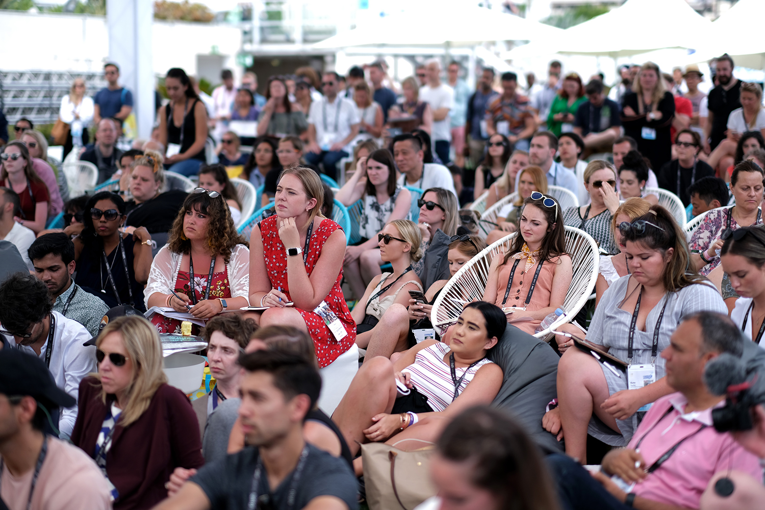
03
Perennial
Engagement
Tokenism has plagued creative industries for decades—the depiction of a
singular diverse individual to express a brand or idea as inclusive. There’s
another form of this that’s more nuanced and is often expressed in seasonal
or opportunistic campaigns.
LGBTQIA+ communities have a word for this concept—rainbow capitalism, when seemingly every major brand slaps a rainbow on their creative during Pride Month to appeal to LGBTQIA+ buyers. But this concept isn’t limited to these communities; we see it for Black and Women’s History months, too, for example.
In addition to marrying brand purpose with goals to diversify, thought-leaders
urged brands to take meaningful actions to acknowledge underrepresented
and underserved communities year-round.
As Unilever’s CEO, Alan Jope, expressed to a packed house on Wednesday,
brands undermine purposeful engagement when their talk is different than their walk. If part of your purpose is to diversify, it’s all in—and all the time—or nothing.

Slide 10
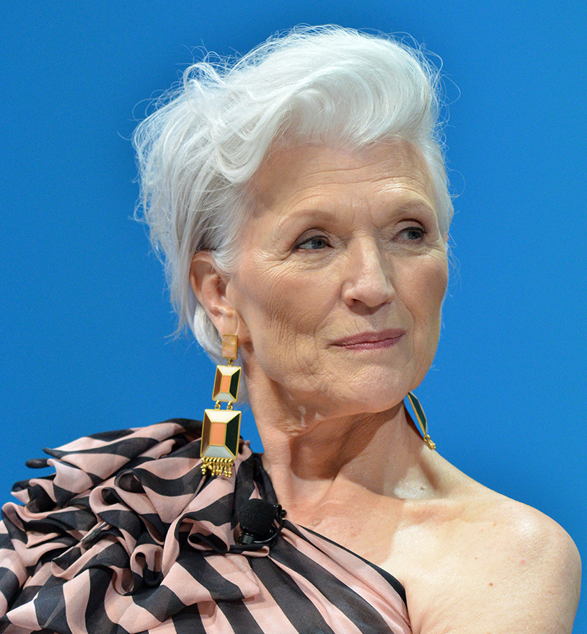

04
Feminism
to the Front
Every day of the Festival, the Cannes Lions Beach hosted an afternoon session, Badass Women, that showcased the best and brightest in our industries. For the premiere session, Kristen Cavallo, CEO of the Martin Agency, used herself as a strong case study of how brands can right-size themselves internally. She and her CCO were the first women execs in 54 years of the agency. Together, they were able to erase the gendered pay gap and support a workforce that’s 67 percent women.
The evidence isn’t just borne out in the
Martin Agency, Cavallo says, but in the better health of business and higher-performing outcomes under women’s leadership. The panelists, and many speakers this year agreed—more women should be executive leaders, and we should be asking men to emulate the successful leadership of women.
The discussions weren’t limited to our internal cultures or board rooms. A week before the Lions kicked off, the UK’s Advertising Standards Authority (ASA) banned ‘harmful’ gender stereotypes in ads. The challenge is in our work too.
Some of this year’s most-awarded creative rebuked those harmful stereotypes and asked audiences to consider the double standards for women. Most notably, Wieden+Kennedy Portland’s Dream Crazier for Nike, which celebrated women athletes for defying the status quo, bringing home 13 awards.
Speakers weren’t shy about their calls for equality. Within media, Madeline Di Nonno, CEO of the Geena Davis Institute on Gender in Media, said to a full auditorium on Tuesday, ‘There’s only one industry in the world that can have gender parity overnight, and that’s media.’
Maye Musk
44%
of 2019 Cannes Lions speakers were women.
Notes:
https://www.bbc.com/news/business-48628678

Slide 11
05
People over 50 in the UK control 80% of disposable income, and 70% in the US
Reimagining How
Inclusion Looks
Especially with intersectionality in mind, speakers expressed how diversity shouldn’t just be addressed by colour and identity—age and accessibility, spoken about less frequently, are great
examples of this.
In Thursday’s The 50+ Goldmine: Sparking Creativity's Coming of Age by AARP, they discussed how age diversity is seldom addressed, but presents such huge business potential. The ‘longevity economy,’ a pithy way describing the opportunity to access ageing populations, is used to express this; Baby Boomers account for half of consumer spending worldwide and hold majority control of disposable income in western countries. And, maybe not surprisingly, many of our leaders felt like this macro-age segment often goes ignored.
This year’s winners addressed this too. L’Oréal’s
Non-Issue, which raked in nine awards this year,
told us that 40 percent of women are over 50, but are shown only 15 percent of the time in popular media.
Accessibility is a similarly oft-ignored idea—one that marginalises people of different ability. Only 0.8 percent of Hollywood’s 100 top-grossing family films depict a person of different ability, and 95 percent of those depictions are by non-disabled actors.
Microsoft won the Brand Experience & Activation Grand Prix on Thursday for its Xbox Adaptive Controller, for providing the best ‘end-to-end experience.’
Microsoft wasn’t alone in focusing efforts on accessibility—Huawei and FCB Inferno also won
for StorySign, addressing deaf audiences,
and IKEA with McCann Tel Aviv for ThisAbles,
add-on products and a campaign for
accessible furnishings.
There’s little commonality between age
and ability, but they both highlight huge opportunities for business. Aside from leaving money on the table, many brands and creatives have also viewed the address of this gap to be
a values imperative.
Cannes Lions Jury President Jaime Mandelbaum, Chief Creative Officer of VMLY&R Europe, told
Ad Age, ‘We are past the point of inclusion being done for the sake of awareness alone. Brands
are really taking action and being part of the solution, not just talking about it: it’s almost the
cost of entry for brands.’

Slide 12


Takeaways
Find Connection
with Your Purpose
Intentionally
Hire Diversely
Mind the Gaps
Measure Differently
If this week showed us anything, it’s that after years of diversity being a topic, measurable change to the industry’s paradigm still requires major commitments from our leaders. In particular, we saw the numerous ways in which we’re ignoring large market segments, especially those 50 years and older and those differently abled. Whether out of fear for addressing these people incorrectly, or the risk associated with big investments, one thing is clear—they’re not going anywhere, they have needs too, and they present a big creative, economic, and strategic opportunity.
Diversity can’t just be expressed in casting and hiring, it must be meaningfully and carefully integrated into a brand’s core values. And when done correctly, the stake brands and organisations take in diversity will make it immutable from the wealth of its talent, its work, and its perception in the market. Tackle the challenge like you would a client or brand imperative—find the white space, make strategic connections to your mission, and use your creativity to help your teams and business partners rally behind the evolution of your position in the market.
Blind casting doesn’t do the job. If we’re to combat the innumerous
ways that our professional and educational systems thwart efforts of underrepresented communities to thrive, we have to intentionally build strategies to sourcing diverse talent. Consider how you can look outside of traditional agency or creative funnels. We heard several creative thought-leaders this week espouse the quality
of work coming from unexpected experience—beyond thinking about diversity from an identity perspective—and extending to life and prior work experience. Add another layer
of richness to your teams and
partners this year.
Consider new key performance indicators for your efforts, ones that delineate internal and market-facing efforts across your diversification imperatives. For example, building nonfinancial goals specific to diversity and inclusion of internal talent, of your opportunity pipeline and of your community contributions may hold your organisation to a different standard of quality for those activities. With respect to business and market-facing efforts, craft aggressive benchmarks that require leadership dedication to achieve measurable results within a year. Lastly, when you hit those marks, congratulate each other quietly in the boardroom, then get to work.

Slide 13
Thank You
Your Name & Title Goes Here

Slide 14


1.
2.
Click the icon in the lower left corner box to add your logo
Copy + paste your logo onto each of the slides
You can delete the “Experience Created by Accenture Interactive” part—we’ll keep that just between us!

