Slide 1







Your Name & Title Goes Here
20
19
BRAND IMPACT
REPORT

Slide 2
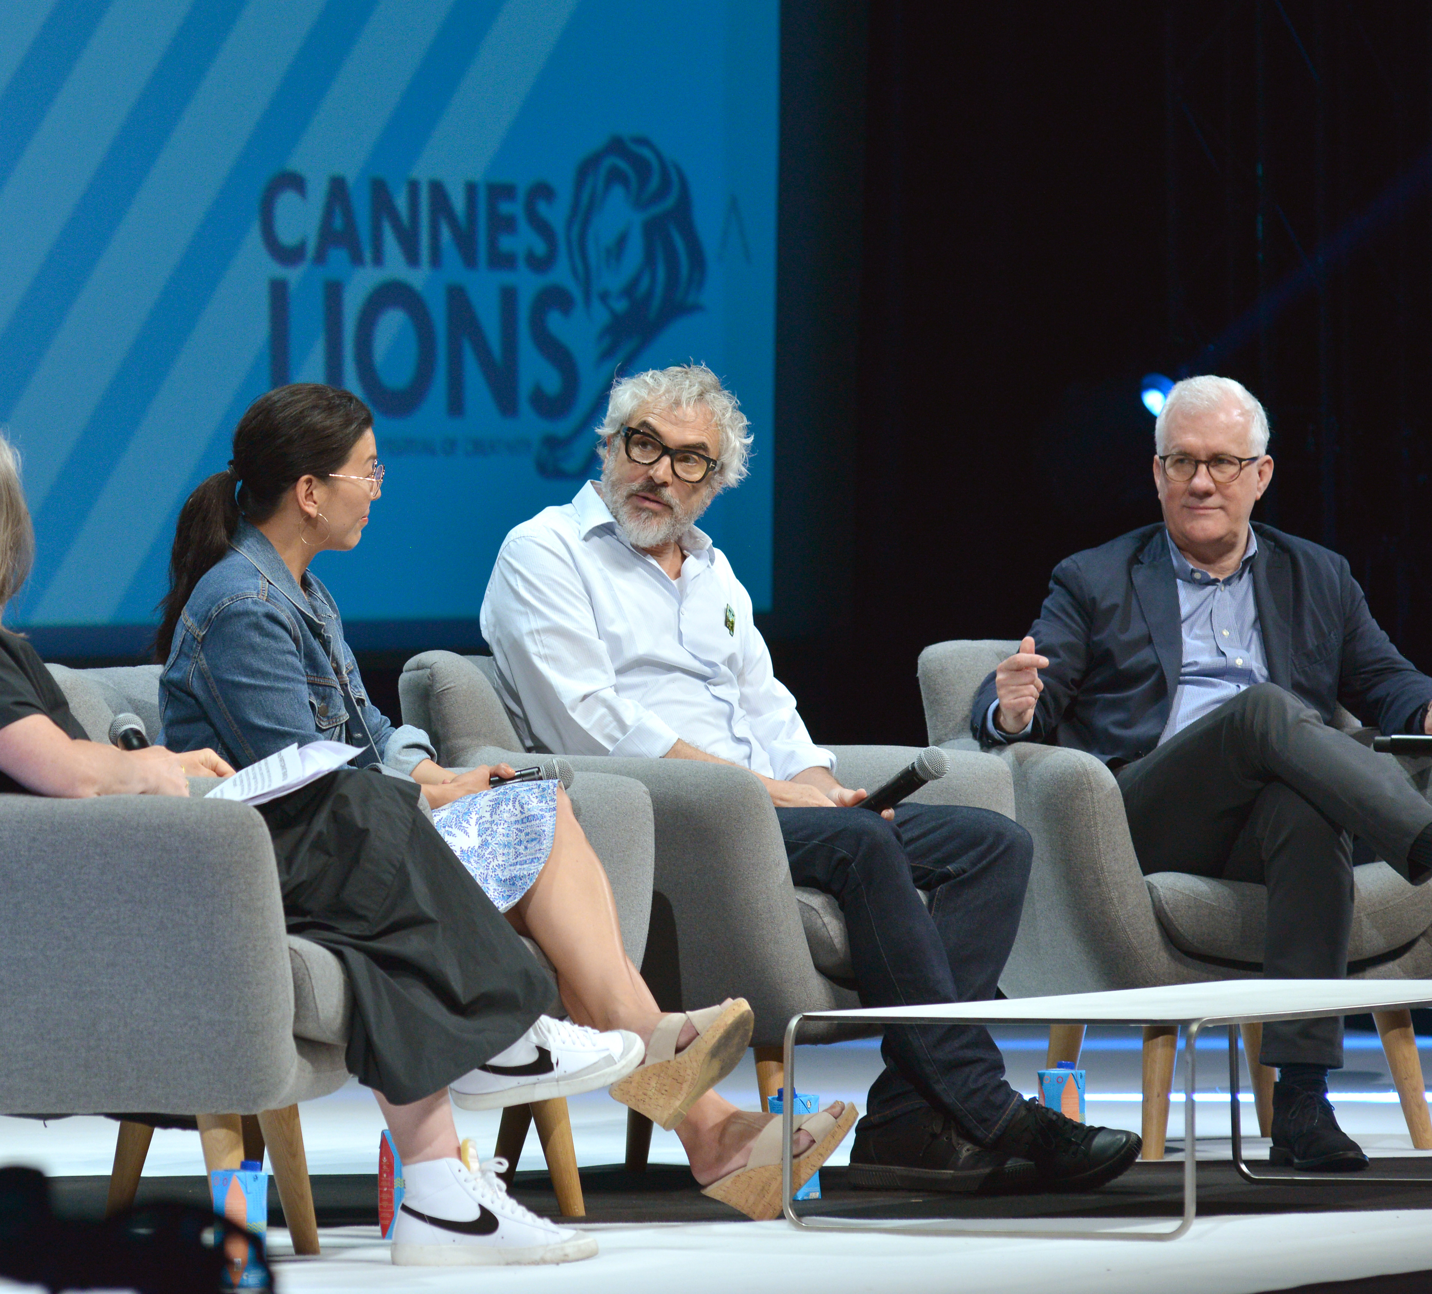
Introduction
Listening. Empathy. Leadership.
Overview of Insights
If Caring Means Sharing,
Who Cares About Brands?
Trends
Brand Impact on Culture
The Value of Brand Listening
Brands Driven Towards Purpose
Brands Fuelling Disruption
Takeaways
The Big Winners
What Happens When Culture Impacts Brands?
Academy Award-winning director Alfonso Cuarón joins David Linde from Participant Media and Ai-jen Poo from the National Domestic Workers Alliance to discuss the movement behind ’Roma’

Slide 3
Theme: Brand Impact
Introduction
Listening
Consumer safaris are not enough. Truly getting to know a customer, whether through digital listening or in person, is changing business models, establishing authenticity and rebuilding trust
Listening. Empathy. Leadership. This is what drives innovation, market disruption, and ultimately, brand purpose.
At the 2019 International Festival of Creativity, leading brands, as well as new entrants, activists, and change organisations built a model for the ways in which creatives can impact or completely disrupt business and culture—and vice versa.
The modern brand can be a change agent for how we behave, how we legislate, how we represent, and how we preserve our world.
As brands evolve to meet these needs, there’s a feeling that a new generation of creatives is saying to customers, ‘here’s a better way, made just for you.’
Empathy
It’s not enough to listen if you don’t demonstrate responsiveness and ingenuity. Understanding a market’s pain points is just the first step toward effectiveness and impact.
Leadership
True creative leadership, which is taking increasingly varied forms, means discovering and committing to accelerating change—and being ready to defend your brand’s purpose.

Slide 4


If caring means sharing,
who cares about brands?
First, a wake-up call: nobody really cares about brands.
77% of brands could simply disappear and not a single customer would care
2019 Meaningful Brands survey powered by Havas
In fact, 77 percent of brands could simply disappear and not a single customer would care, according to the 2019 Meaningful Brands survey by Havas. The same group claimed that 58 percent of brand content is not meaningful, leaving more than half of content falling by the wayside.
No matter how much media you may have, you
can’t force creative down customers’ throats. It’s not
just about an attention deficit; creatives and marketers
must break through algorithms and then make consumers immediately care or find a connection to something they already care about.
Many Cannes Lions speakers asserted that highly
emotional content is the highway to sharing;
in short, if you care, you share.
And though it may be counter-intuitive to some, you have to think small to launch big, going after enthusiasts in need. It’s a game of niche rather than mass—otherwise messages may become so bland and diluted you risk losing all care and impact.
The impact of sharing and earned media is huge. According to IPA Databank, which this year outlined ways in which conversations shape culture, earned media boosts effectiveness by 26 percent.
The opportunity to drive conversation and cultural zeitgeist is why we see an uptick in experiential, guerilla marketing, stunt PR, and social activations as leading buzz tactics for cultural change makers worldwide.
Capitalize on low hanging fruit
to identify a ballpark

Slide 5
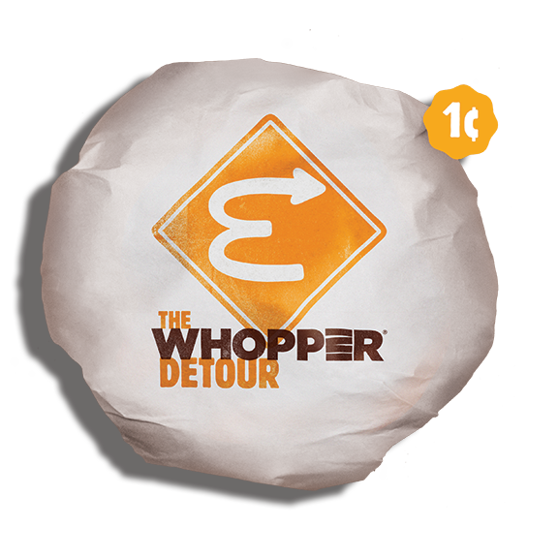
Theme: Brand Impact
Trends
02
The Value of Brand Listening
01
03
In a world of AI, machine learning, and automated listening, human community managers and consumer researchers are still our best way to understand audiences. As machines become more powerful, qualities that are uniquely human—displays of empathy, creative mindset, and intuition—are mandatory when curating the right customer experience and knowing the best time to act.
Brand Impact on Culture
Brands Driven Towards Purpose
04
Whether fighting taboos, saving the environment, or swerving customers from a competitive burger joint, brands are employing creative judo to change the momentum of cultural conversation.
Brands Fueling Disruption
Armed with brand purpose, creative leaders are standing up to shareholders saying what’s right for the brand is right for the business. But amidst calls for social change, ethical principles, diverse voices, and world health—are brands giving back as much equity as they are borrowing?
Whether rethinking stagnant industries or developing brand new ones, technology that delivers on consumer needs first is in the front seat of business disruption.

Slide 6

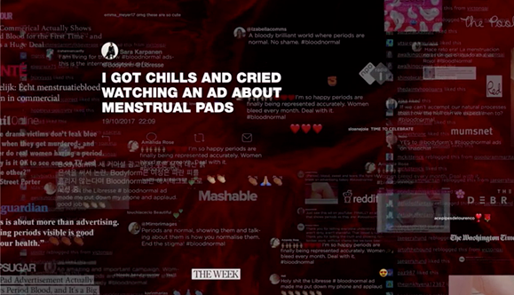
01
Courage is as contagious as fear... There is no bravery without empathy.
– Nadja Lossgott, Creative Partner at AMV BBDO, speaking during a Wednesday session, There Will Be Blood: Brand Activism Gets Messily Effective
Brand Impact on Culture
Redirecting momentum with cultural judo
Feminine care group Essity was fed up.
After building a campaign to fight back ingrained cultural taboos around a natural process—women’s periods—they found themselves embattled with media companies who refused to take an honest look at menstruation. Essity was seeing red and wanted consumers to see it as well.
As described in this week’s session, ‘There Will Be Blood,’ Essity and BBDO turned their pad brand Libresse red to fend off the sanitised blue liquid we’ve become accustomed to in feminine care commercials. Their hope was to destigmatise the idea that periods caused women to be smelly and dirty with images of embroidered bloody underwear, blood in the shower, and yes, blood on a pad.
TV stations said no, and that was when the real work began. Essity and BBDO were just a few of the brands at Cannes who found themselves playing creative judo: taking the momentum of existing conversation—be it organic consumer conversation or that around other brands—and redirecting it to their benefit.
Libresse’s #bloodnormal campaign reached number one in share of voice by promoting biased and negative comments which its community was quick to self-regulate. This week in the Palais, the team stressed that the ingredient to their success was empathising with women and firing up feelings they had buried about shame. ‘Courage is as contagious as fear… there is no bravery without empathy.’

Slide 7

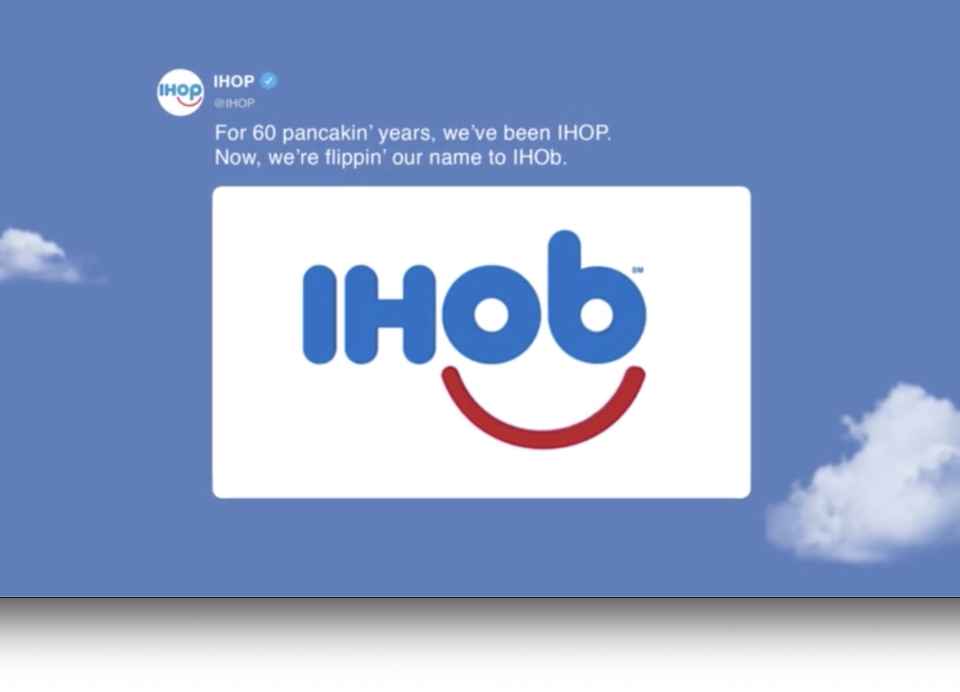

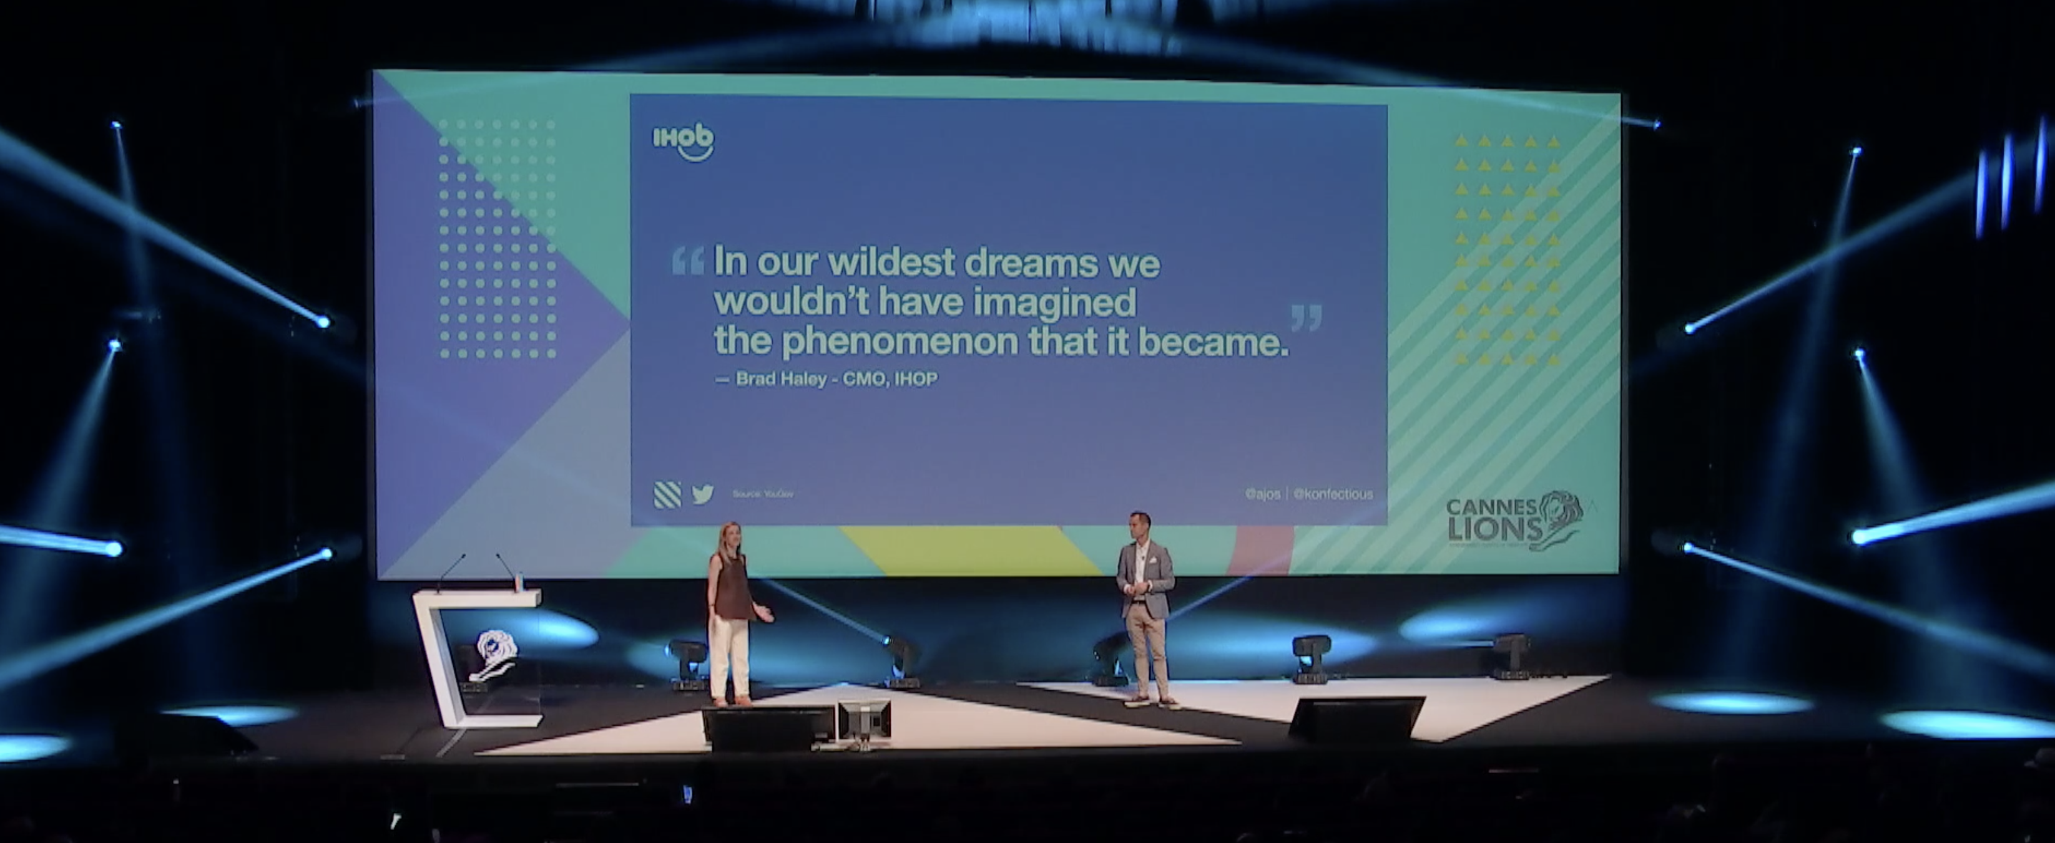
But many other Lions-nominated examples employed creative judo
as a way to co-opt cultural conversation.
Droga5’s campaign for IHOP sought to commandeer burger
conversation by reimagining its own brand focus switching from
pancakes to burgers, renaming the restaurant chain IHOB.
The activation quadrupled IHOP’s burger sales, not only building awareness for broader product availability in the restaurant but
also stealing a 60 percent share of burger conversation on Twitter.
Not to be outdone, Burger King has also mastered the art of redirection.
Since 2017, the brand has been turning up the heat for competitors,
co-opting angry tweets from Wendy’s customers who were upset about losing spicy chicken nuggets from their menu. Burger King saw Wendy’s loss as their gain, adding nuggets to their own menu and using Wendy’s complaints in their own advertising to sell out of three months of nugget inventory in just four weeks.
This year, Burger King took home the Direct Grand Prix for its ‘Whopper Detour,’ which geofenced McDonald’s locations and sent customers to the nearest Burger King with the promise of a one-cent Whopper.
In short, food brands are stirring it up.
Capitalize on low hanging fruit
to identify a ballpark

Slide 8
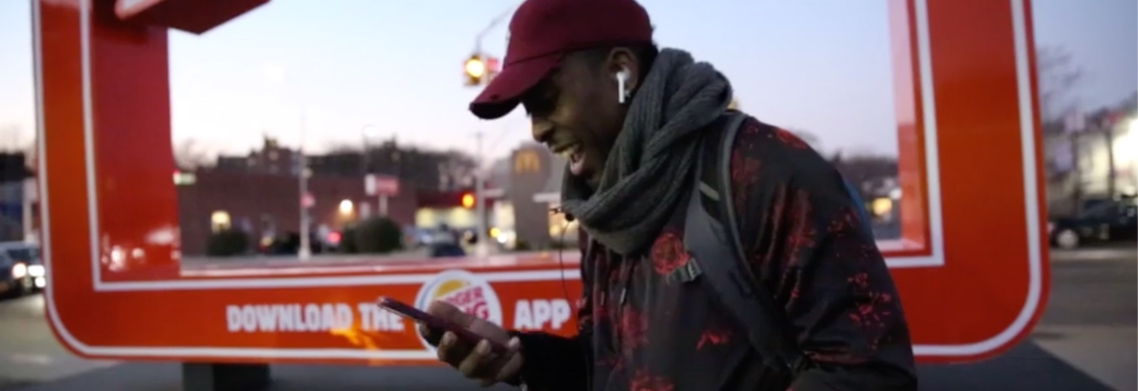

Outside of quick service restaurants, look no further than this year’s Super Bowl to see great examples of creative judo. The #VolvoInterception campaign mobilised Big Game watchers to declare their Volvo brand loyalty and purchase intent during one of sports culture’s biggest moments—not to mention their competitors’ ads.
Any time another car company aired a commercial during the game, viewers could tweet at Volvo to nominate a family member or friend whom they thought deserved to win one of its cars, generating a 70 percent sales lift for Volvo entirely off competitive promotion.
The impact of brand judo can have bigger implications than product sales. Many times it is a clear statement on brand purpose. Domino’s Pizza’s Paving for Pizza campaign cheekily used humour to drive connectivity between its product quality and U.S. road infrastructure, pushing customers to invest in their communities.
Capitalize on low hanging fruit
to identify a ballpark

Slide 9
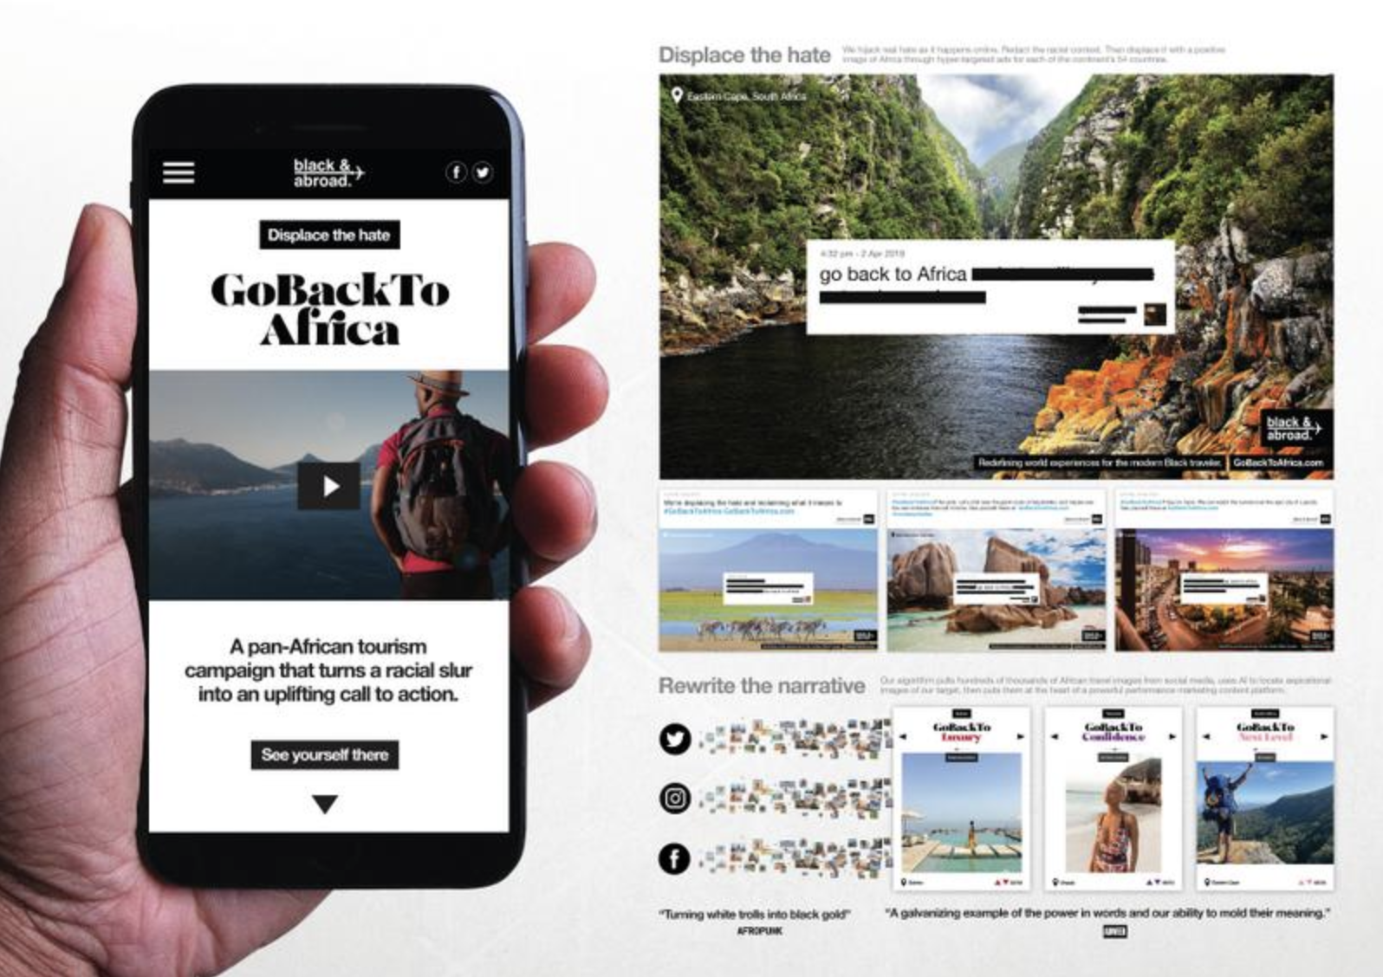

Sometimes creative judo overlaps with identity and value-based content. That
was embodied in FCB’s campaign ‘Go Back To Africa,’ which won the Creative Strategy Grand Prix.
The campaign used social listening
to identify harassing and racist messaging and then, after censoring hate speech, turn it into a promotion
to travel to Africa with curated experiences from Black & Abroad.
The racist posts were placed in front
of African landscapes and promoted to Black travel intenders.
In many of these examples, from Essity to Burger King, we see brands growing their campaigns year-over-year, never shortchanging creativity but committing for the long haul.
Statistically we’ve seen that brand activations focused on quick wins don’t ultimately drive sales. Short-term creatively awarded campaigns are around 50 percent less effective than long-term awarded campaigns, according to ‘The Crisis in Creative Effectiveness’ study by Peter Field and the Institute Of Practitioners In Advertising (IPA).
Volvo’s Super Bowl campaign is a
huge spike in momentum for the brand that it continues to sustain over time. Not every brand is adept at being able to do this. In fact, 52 percent of business leaders, including 30 percent of senior-level marketers, rate their knowledge of brand building as average to very poor, in spite of being responsible for setting marketing objectives across both the short- and long-term.
52%
of business leaders rate their knowledge of brand building as average to very poor
—The Crisis in Creative Effectiveness,
Peter Field and the Institute Of
Practitioners In Advertising (IPA).

Slide 10
02
The Value of
Brand Listening
Listen well before starting a conversation
The message was clear across the festival. Have a beer with your customers. Understand their needs. That’s right, take out your AirPods and really listen. And not just to people currently buying your products or receiving your mass messages. Brands should take aim at joining niche conversations where they can engage with purpose and meet consumer passion points.
In a world of AI, machine learning and automated listening tools, human-to-human contact is not a thing of the past. Community managers and consumer researchers are still our best way to understand audiences. As machines become more powerful, qualities that are uniquely human—displays of empathy, creative mindset, and intuition—are mandatory when curating the right customer experience and knowing the best time to act.
Humans who know the brand must decide when to create content and take opportunity risks. If you get timing wrong, you may be seen as jumping on a bandwagon or worse, tone-deaf.
26%
Capitalize on low hanging fruit
to identify a ballpark
Earned media boosts effectiveness by
— Media in Focus—Marketing Effectiveness in the Digital Era (IPA, 2017)

Slide 11
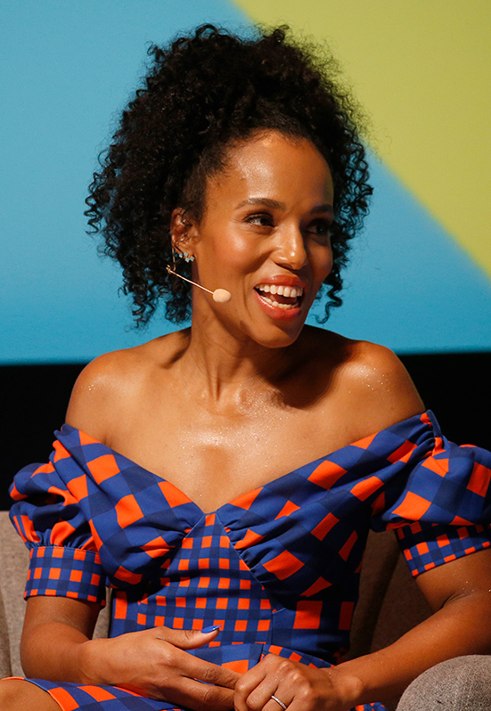
Creators in Cannes were strong
advocates for listening.
Actress Kerry Washington pushed on her partnership with Neutrogena to make certain that the brand was hearing the needs of a diverse customer set. More than a spokesperson, Washington is a creative collaborator for Neutrogena, with her own lines of makeup that have evolved her input with the brand.
At the Festival, Washington reiterated that she won’t advocate for a company that doesn’t listen to and represent diverse customers. Washington told attendees that when she started working with the beauty brand, their darkest foundation colour was ‘tan’; suffice to say, it was too light.
When Neutrogena corrected the problem and developed new products, Washington asked them to find previous consumer feedback about lack of colour options and reach out to those fans. As thanks for their input, they were invited to a video chat with a secret Neutrogena employee, Washington herself.
It comes back to empathy. ‘Design thinking [is] all about building empathy with consumers, about listening with your eyes, and about taking that empathy and linking it to brands and corporate strategy to solve tricky problems,’ said Andrew Barraclough, Vice President of Global Design and Innovation, GlaxoSmithKline.
Barraclough cares about GSK on a personal level, and he feels that when employees care about a brand internally as a culture, it can be emulated more easily externally in our campaigns.
The big truth about why brands have to have empathy? Because no matter how much we put into them, ultimately brands belong to the consumer.

Slide 12
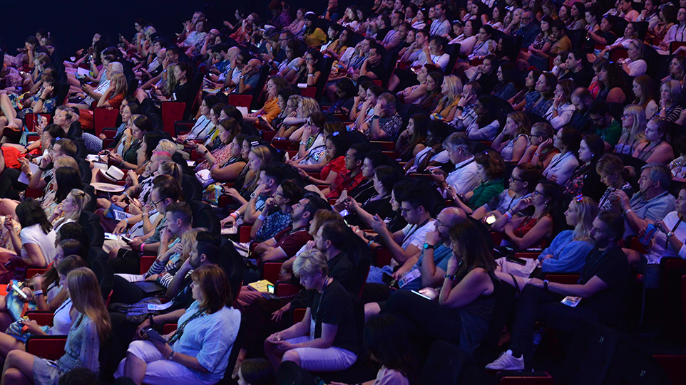

03
Brands Driven Toward Purpose
Defining brand purpose can have a greater impact on ROI, effectiveness, and your organisation at large. According to Forbes,
75 percent of consumers expect brands to contribute to their well-being and quality of life. The challenge is how to build a brand based on ethical principles and focused on the importance of purpose to their audience while keeping mindful of the bottom line.
This was the centrepiece for discussion in this week’s BIG Debate, hosted by The Economist. Is the business of business to create value for shareholders or value for the world? PepsiCo’s Todd Kaplan said his company is leading ‘performance with purpose,’ asking why each of Pepsi’s brands exist and what is its role in the
world. This keeps the brands from acting outside
of that purpose or acting only for shareholder appeasement.
Armed with brand purpose, creative leaders are standing up to shareholders; saying what’s right for the brand is right for the business.
Not every brand is walking the talk, however. According to IPA, 75 of marketers say short-termism is winning over long-term brand objectives as share prices trump what some would say is doing the right thing.
Microsoft’s Kathleen Hall noted that there’s also a distinction between brand values and politics.
Microsoft’s core values are used to align employees with where the company stands. Based on those values, the brand knows when to take action or intervene. Microsoft feels a strong responsibility to its local communities, shareholders, and employees. There are times, Hall says, when ‘we’ve waited long enough for this to be handled by a government entity and now we’re stepping in.’ Under this leadership and alignment on values, Hall points out Microsoft’s shares rose $100 in 10 years. Notably, it also took home the Brand Experience & Activation Grand Prix for its Xbox Adaptive Controller.
Is brand purpose easier for private companies who aren’t under the close watch of shareowners? ‘It's not a public or private thing. It's a conviction thing,’ Kaplan said.

Slide 13




So amidst calls for social change, ethical principles, diverse voices, and improvements in world health—are brands giving back as much equity as they are borrowing? And how can they best do that?
The trick is to create content that implants itself in people’s memories and drives them toward impact. Often, it involves the right partnership between an activist, an organisation, and a great storyteller. A common sense of activism is important, lest you run the risk of being seen as opportunistic. The goal should be generating willing participation among consumers: putting the focus back on people rather than products.
This year’s Festival featured a number
of political and social issues, from government gridlock to environmental sustainability, and preventing illness to raising cultural awareness:
A blank newspaper won the Print and Publishing Grand Prix (Impact BBDO, Dubai) as Lebanese daily An-Nahar made a direct statement about government gridlock
DoBlack, winner of this year’s eCommerce Grand Prix (Doconomy and RBK Communication), is a
credit card designed to decline transactions when card owners have exceeded the carbon limit needed to cut carbon emissions in half by 2030
Unilever’s Lifebuoy helps millions of parents stay ahead of infections so that their children fall sick less often, using mobile outreach in remote geographies
2x
Brands with purpose have grown 2x faster than others in the past 12 years
91%
of millennials switch brands based on social issues
So amidst calls for social change, ethical principles, diverse voices, and improvements in world health – are brands giving back as much equity as they are borrowing? And how can they best do that?
The trick is to create content that implants itself in people’s memories and drives them toward impact. Often, it involves the right partnership between an activist, an organization, and a great storyteller. A common sense of activism is important, lest you run the risk of being seen as opportunistic, The goal should be generating willing participation among consumers, putting the focus back on people rather than products.
This year’s festival featured a number of political and social issues, from government gridlock to environmental sustainability, preventing illness to raising cultural awareness:
A blank newspaper won the Print and Publishing Grand Prix (Impact BBDO, Dubai) as Lebanese daily An-Nahar made a direct statement about government gridlock
DoBlack, winner of this year’s eCommerce Grand Prix (Doconomy and RBK Communications), is a credit card designed to decline transactions when card owners have exceeded the carbon limit needed to cut carbon emissions in half by 2030
Unilever’s Lifebuoy helps millions of parents stay ahead of infections so that their children fall sick less often, using mobile outreach in remote geographies
In addition to Essity’s #bloodnormal, feminine hygiene products came to the forefront of discussion this year as “The Tampon Book” won the PR Grand Prix for placing 15 organic tampons inside a book’s packaging so they could be sold without the discriminatory tax on menstrual products
Hulu tackled the topic of women’s erasure in history by highlighting that of the roughly 150 statues in New York City, only five are women. Hulu fixed the gap by bringing new silhouette to town in time for the premiere of the Handmaid’s Tale, CMO Kelly Campbell told a panel
A Johnson & Johnson-commissioned documentary about nurses in the early days of AIDS epidemic won the Entertainment Lions Grand Prix. Elsewhere in entertainment activism, a panel explored the impact campaign around the film Roma, highlighting 2.5 million domestic workers who do not have basic worker’s rights. The campaign instigated a cultural shift in viewers, accelerate the work of impact organizations
Knorr addressed sustainability and food security looking at the impact of food growth on wildlife and plant life. On the same panel, Chocolonely discussed tools to address child labor issues and make their supply chain transparent. Chocolonely created 12 non-financial KPIS, validated by PWC, to transparently define and track benchmarks honestly and keep their audience engaged

Slide 14
In addition to previous success of Essity’s #bloodnormal campaign, feminine hygiene products came to the forefront of discussion this year as ‘The Tampon Book’ won the PR Grand Prix for placing 15 organic tampons inside a book’s packaging so they could be sold without the discriminatory tax on menstrual products
Hulu tackled the topic of women’s erasure in history by highlighting that of the roughly 150 statues in New York City, only five are women. Hulu fixed the gap by bringing new silhouettes to town in time for the premiere of The Handmaid’s Tale, CMO Kelly Campbell told a panel
A Johnson & Johnson-commissioned documentary about nurses in the early days of the AIDS epidemic won the Entertainment Lions Grand Prix. Elsewhere in entertainment activism, a panel explored the impact campaign around the film Roma, highlighting 2.5 million domestic workers who do not have basic worker’s rights. The campaign instigated a cultural shift in viewers, and accelerated the work of impact organisations
Knorr addressed sustainability and food security, looking at the impact of food growth on wildlife and plant life. On the same panel, Tony’s Chocolonely discussed tools to address child labour issues and make their supply chain transparent. Tony’s Chocolonely created 12 non-financial KPIs to transparently define and track benchmarks honestly and keep their audience engaged
64%
of global consumers choose a brand based on social action
6 in 10
don’t trust a brand until they see proof of its promises

Slide 15

04
Brands Fueling
Disruption
This year in Cannes, we saw disruption in firmly established industries and disruption in remote markets where industry best practices could never work.
In developing countries, the flow of innovation is changing. With no legacy systems, creative innovators are playing leapfrog over well-established nations given a blank slate. With less regulation and governments thirsty for change, as well as cheaper technology costs to implement new tech rather than build roads and infrastructure, creatives are problem-solving and investing in areas that the Western world has not fully bought into.
Local talent is rising up to meet this need. Such is the case with Zipline, a drone delivery service helping the medical community in Africa by skipping roads altogether, bringing blood, vaccines, and other critical aid anywhere in Rwanda, on-demand, in 15-20 minutes.
Flying autonomously and on locally developed batteries, drones prevent the need to cold store large supplies in hospitals. Doctors and nurses can place supply orders as frequently as needed and receive an SMS message when their package is parachuted from the sky minutes later. Without the need for cold-chain infrastructure and with waste elimination on-site, the programme paid for itself. Home deliveries globally are not far behind.
Whether re-thinking stagnant industries or developing brand new ones, technology that delivers consumer need first is in the front seat of business disruption

Slide 16
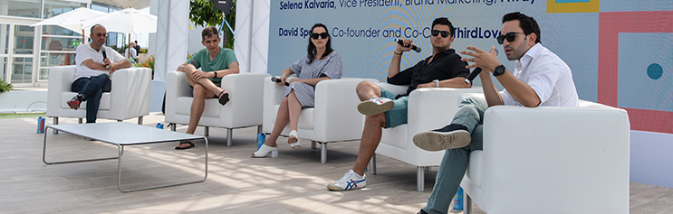





Then there are the mass-market upstarts, who have been quietly studying
their industry’s weak spots for years and have decided to change the
game by acting like a different style of company altogether. This is the
direct-to-consumer revolution.
One of the most popular of the new breed is Away, which bills itself as a
travel company, not a luggage company; its brand purpose is attached to the emotional experience of wanderlust, not the features and functionality of your carry-on. PR and influencer campaigns are critical to Away’s expected expansion to more than 50 brick-and-mortar stores coming soon.
Hubble, a disruptor in the contact lens space, asked optometry experts what the greatest pain points were in the market, zeroing in on why contact lens buyers were experiencing complications from overwear. Hubble then designed a new model aimed at affordability and better access.
Similarly, Candid, an orthodontic aligner company, studied three years of competitor Invisalign’s marketing before deciding to take a more expert medical approach to their brand, investing in personalised 3-D modelling for the consumer, building trust and education in how their product works. While admittedly the additional education added friction to their funnel, Candid felt they were appropriately upfront with consumers who would be more satisfied and confident in their experience.
Leaders from Hubble, Away, Candid, and ThirdLove speak on the Terrace Stage about new blood brands changing the game

Slide 17
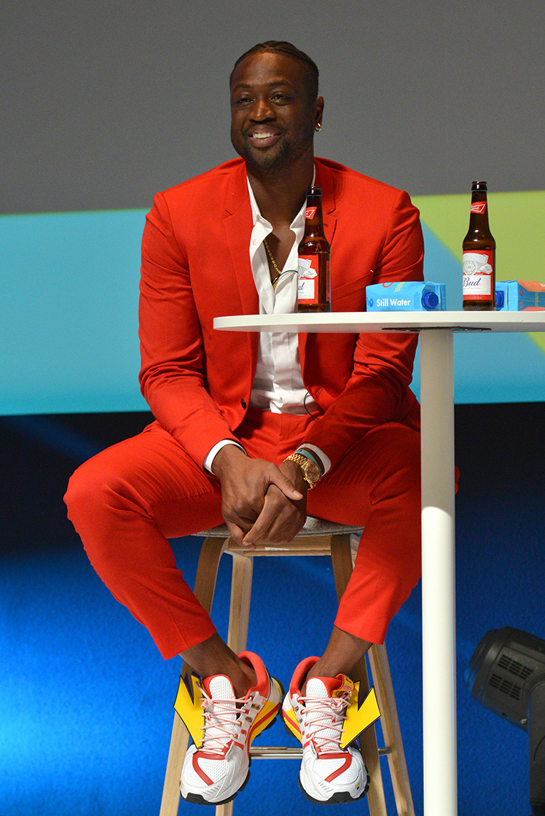

Takeaways
What Happens When Culture Impacts Brands?
The Big Winners
As was highly anticipated, Nike’s ‘Dream Crazy’ omni-channel campaign, in partnership with Wieden+Kennedy, masterfully tapped into the existing cultural conversation, fueled disruption and empathised with purpose, sparking controversy and earned media, and redirecting the conversation around identity.
‘Dream Crazy’ boosted the brand’s market cap by $6bn in less than three weeks. Its cultural impact cannot be understated, especially shoulder-to-shoulder with other Lions-winning creative like Childish Gambino’s ‘This Is America.’ Together, they tapped into cultural discontent, recognising what Ad Age and many consumers feel is the ‘corroded American dream.’
Culture is not an easy thing to control. As seasoned brands know, any time can be a ripe time for a crisis. The modern CMO may live in fear of presidential tweets, product recalls, or even television plot lines.
Most might be happy to see their product featured on one of network TV’s top-rated series. But before getting too excited, if you’re the creative leadership for Crock-Pot and that show is award-winner This Is Us, you’ll be watching your product kill off a beloved character.
Employing the same techniques of listening, empathy and leadership helped Crock-Pot respond, turning a situation that could have gone up in flames into a $300,000 sales lift.
NBA All-Star and Olympic Gold Medalist Dwyane Wade discusses social impact with Budweiser

Slide 18

Takeaways
Think small to launch big
Having a clear brand purpose will keep you focused in your lane and able to
look for the needs of niche audiences where you can make a clear impact.
Listen with empathy
Changemaker brands succeed at serving what the consumer truly
wants and understand that the brand ultimately belongs to them.
Learn from machines but trust a human
Put your data and brand trust in the hands of a human who can
understand when it is time to take risks and how to rethink creative solutions.
Redirect the conversation
Take control of cultural discussion by employing creative judo and harnessing competitive momentum.
Beware that activism isn’t opportunism
Balance the equity your brand gives with what you borrow as you can’t wash off claims of insincerity.

Slide 19
Thank You
Your Name &
Title Goes Here

Slide 20

Feel Free to Share this with Your Team
1.
2.
Click the icon in the lower left corner box to add your logo
Copy + paste your logo onto each of the slides
You can delete the “Experience Created by Accenture Interactive” part—we’ll keep that just between us!

